Slide 1
Welcome to cs50 Section!
Please find a partner and start the activity on the blackboard (any of them!) Then find a new partner and board!
Notes:
Andrew’s intro activity plan:
I’m going to put bubbles up on the boards such as 'food you like', 'places you want to visit', 'things you want to learn this year' and so on, and students have to pair up and connect their names to the bubble, to each other's names and then whatever it is they have in common or talked about, e.g. '(food bubble) - Andrew - pizza - Patrick - (food bubble)’. The idea is to start learning some names, have some pair conversations and find out a bit about each other for random topics to break the ice a bit in a more natural way, where you have to have a bit of a conversation to find something in common, something you both hate, an unpopular food opinion you share etc ☺

Slide 2


Attendance code!

Slide 3
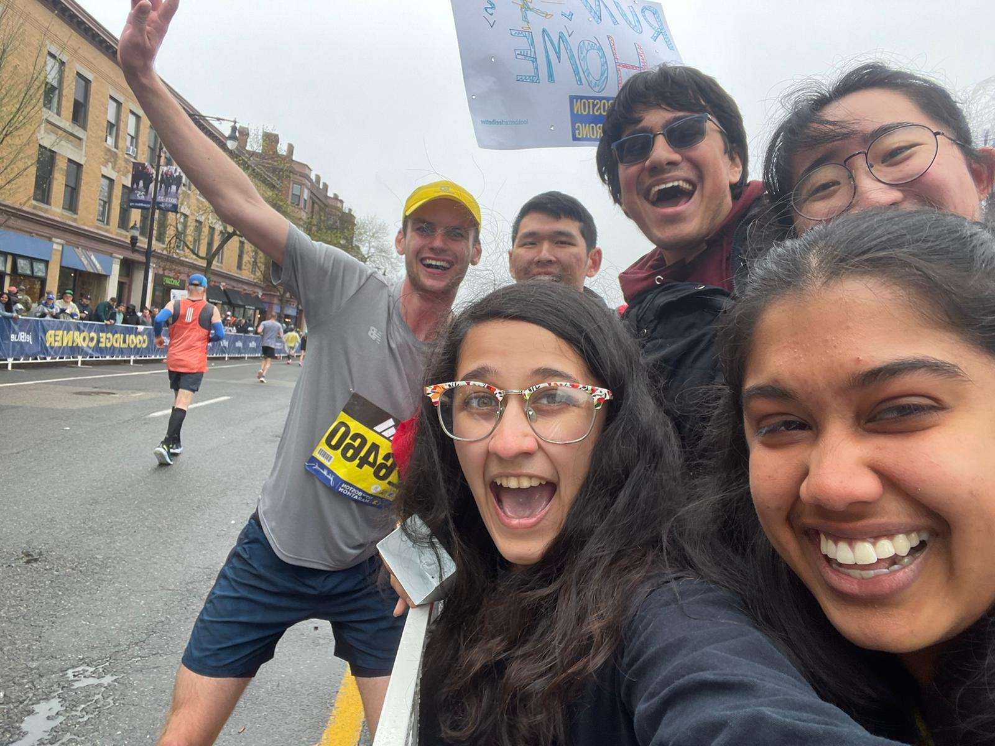
Andrew Holmes Cabot House, Senior
B.A. in Computer Science
Some of my passions:
Running
Soccer
Dog walking & hiking
Card & board games
Video games
Teaching!
aholmes@college.harvard.edu

Slide 4
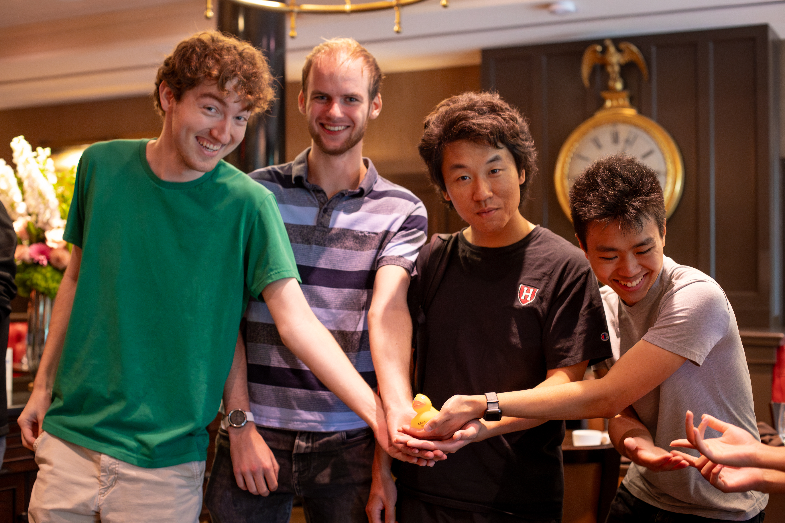
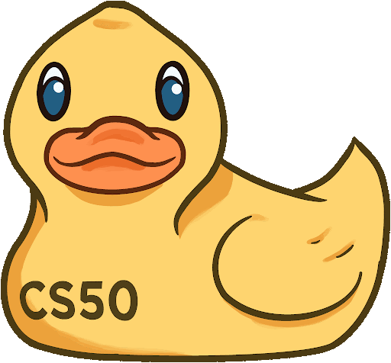
My Teaching
Fall 2021: CS50 CA
Spring 2022: CS51 CA
Fall 2022: CS50 TF
Spring 2022: CS124 TF
Fall 2023: CS50 Head TF

Slide 5
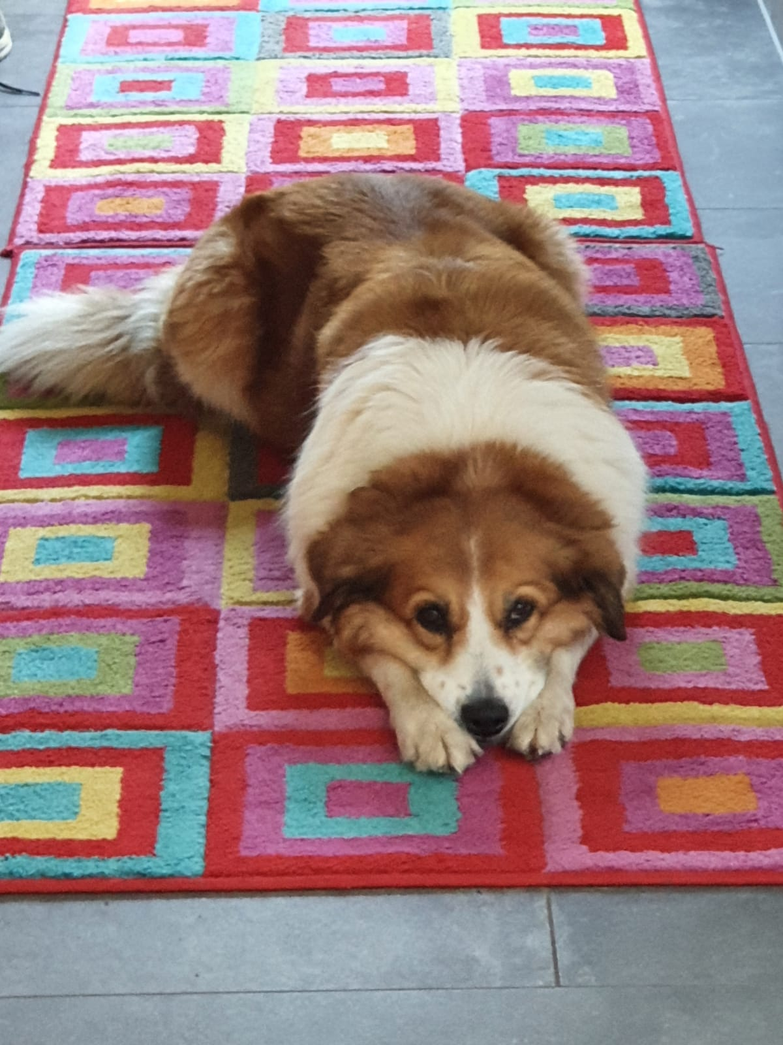
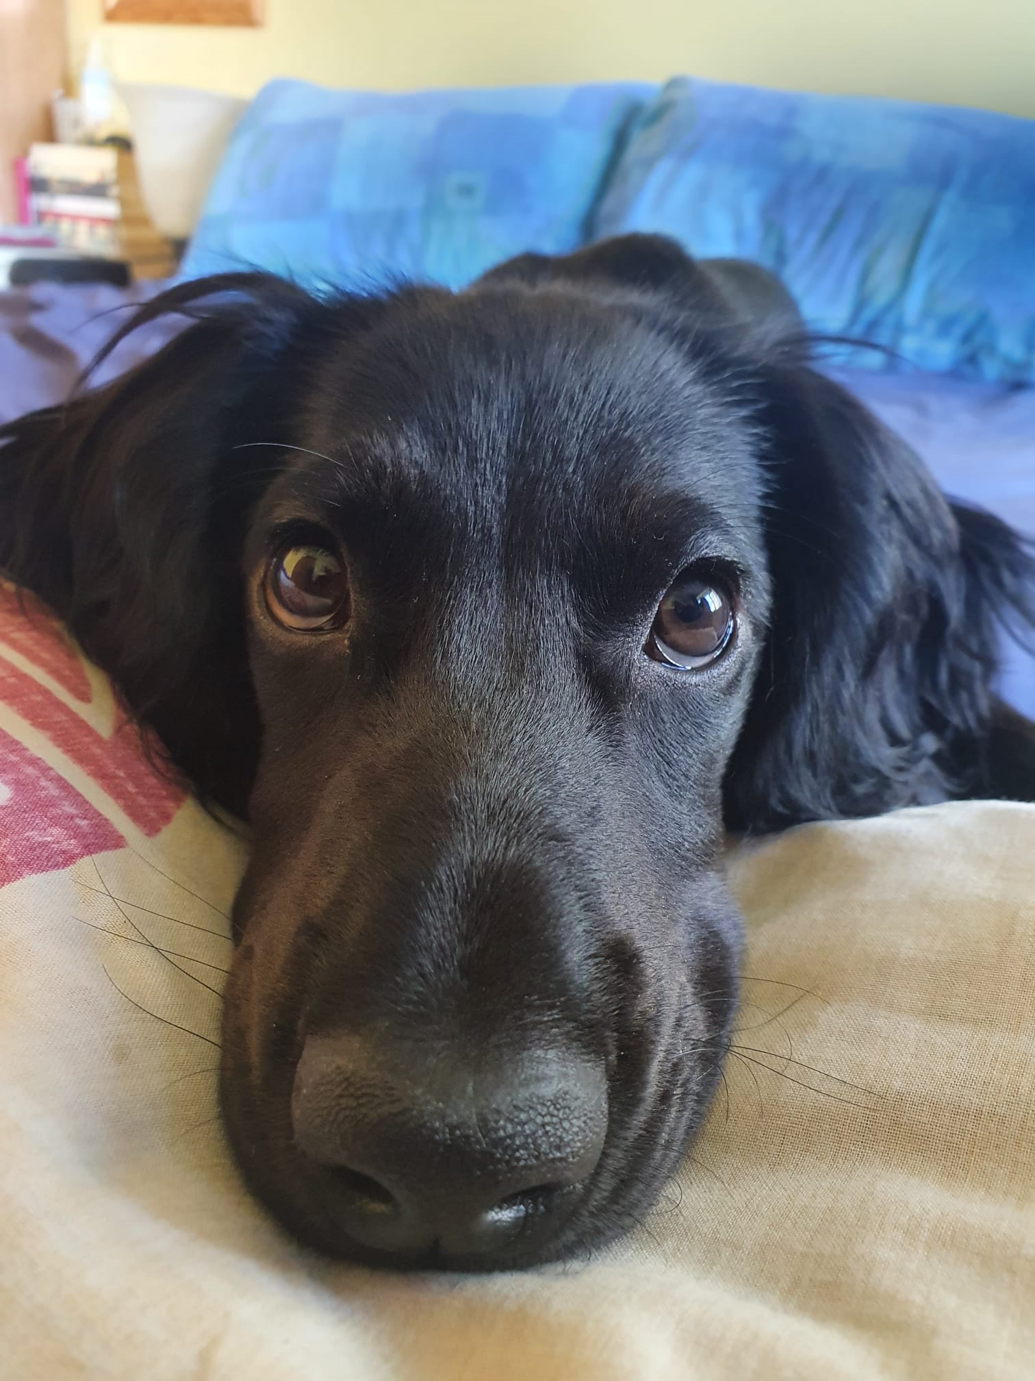
My Classes
Current
CS165: Data Systems
CS153: Compilers
Phil 140: Logic
?
Past (CS-related)
CS124, CS181, CS182, CS262, CS238, CS91, CS121, CS61, CS51, CS50, STAT110, Math22a, Math22b

Slide 6
Weekly Course Schedule
Logistics
 |  | Mon | Tue | Wed | Thu | Fri | Sat | Sun
Lecture
Section
Office Hours
Sunday OHs

Slide 7
Section
Logistics
Section is…
Section is not…
A review session to consolidate lecture understanding.
A place to meet friends in the class!
A place to practice what you’ve learned…
and to ask questions about things you still find confusing!
A small, supportive group effort.
We’re here to have fun while learning!
The place for fixing your PSET code (that’s office hours!)
The place for being on your phone.
A place to be rude, unsupportive or in any way not cool to others – I will not tolerate it.
Optional… it’s required for attendance points for you grade :P
If you can’t make it one week, please contact me so I can help!

Slide 8
cs50 section 1
Intro to C
Andrew Holmes, Fall 2023

Slide 9
Today’s Plan
Scratch → C
More C!
01
03
Writing your code
PSET thoughts
02
04
From blocks to your first lines of code :)
Delving deeper into C’s syntax! Loops, conditionals + more!
Getting setup with cs50.dev and writing some code!
Taking a look at PSET 1!

Slide 10
01
Scratch → C
Converting our Scratch understanding to our first programming language!

Slide 11
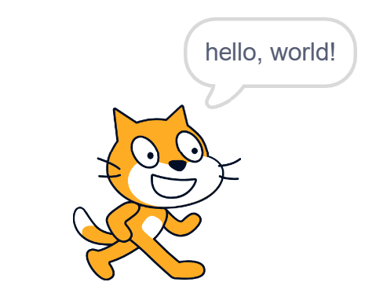
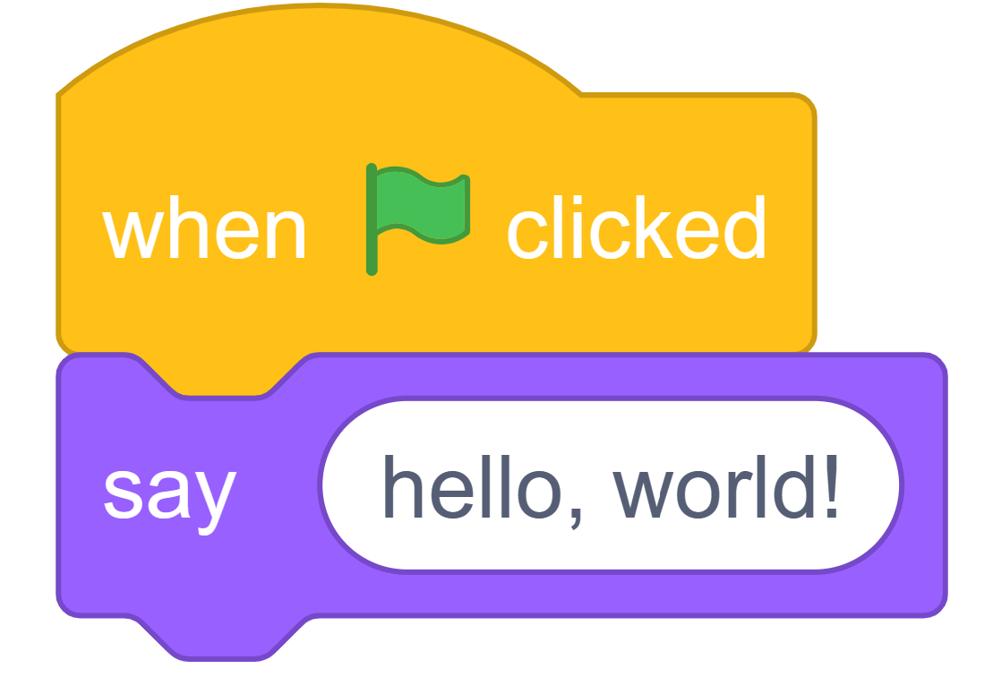
Basic Scratch program
Scratch → C

Slide 12
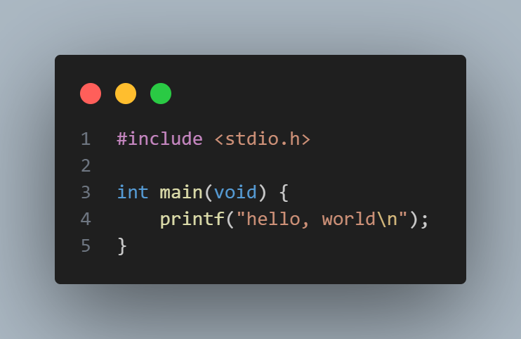
C Equivalent for hello world
Scratch → C

Slide 13
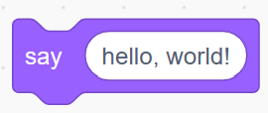
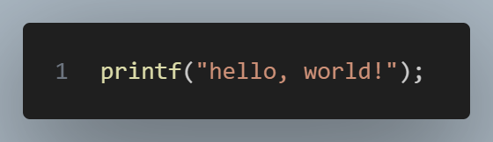
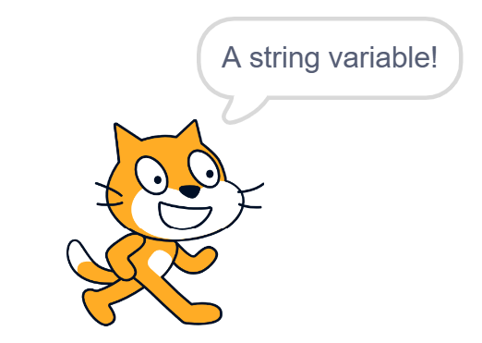
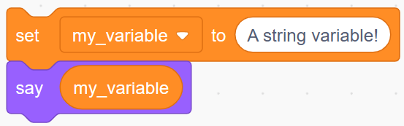
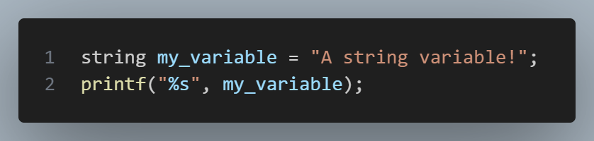
Scratch ‘say’, C printf
Scratch → C
printf → print formatted string

Slide 14
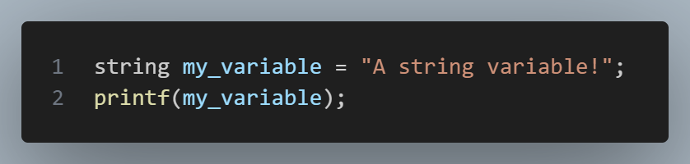
But Andrew… %s? huh?
Scratch → C

Slide 15
Scratch → C
VS
AVOID THIS ONE. IT IS A SECURITY RISK.

Slide 16
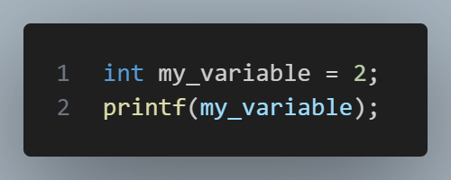
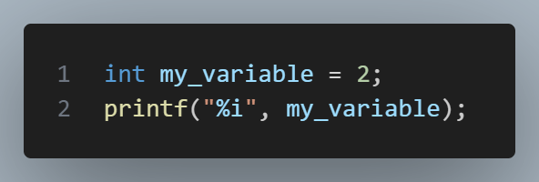
It also prevents…
Scratch → C
INVALID C syntax. printf REQUIRES a string as input.
VALID C. my_variable is an int, but is formatted as a string.

Slide 17
int main(void)
Scratch → C
main is a special function that is run automatically when you execute the compiled file. (more detail later)

Slide 18
#include
We use the include keyword to import libraries (header files).
stdio → Standard Input/Output
Lets us use the printf function.

Slide 19
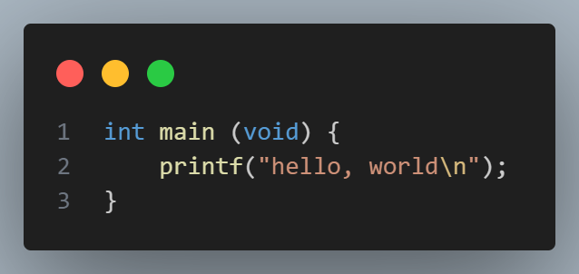
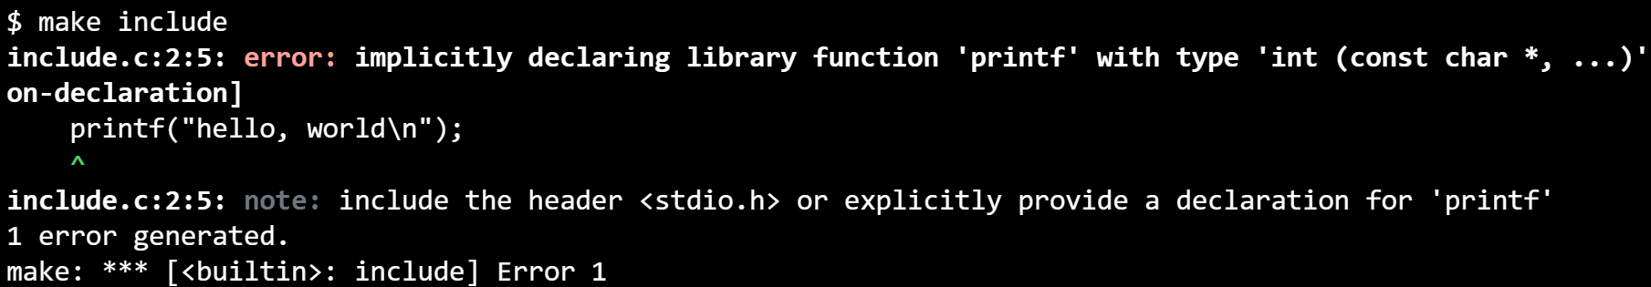
I don’t need no help
Scratch → C

Slide 20
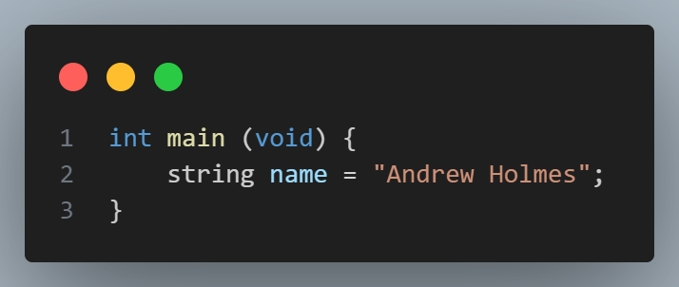
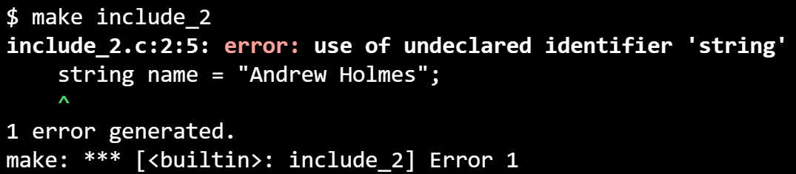
cs50.h
Scratch → C

Slide 21
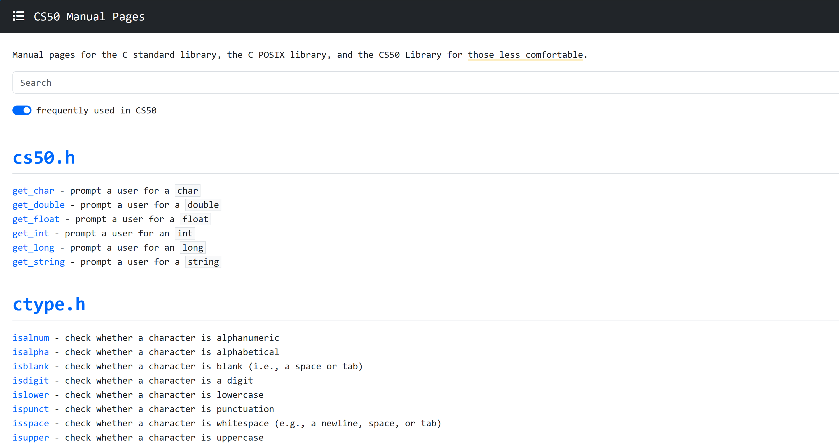
Scratch → C
manual.cs50.io

Slide 22
printf - CS50 Manual Pages

Slide 23
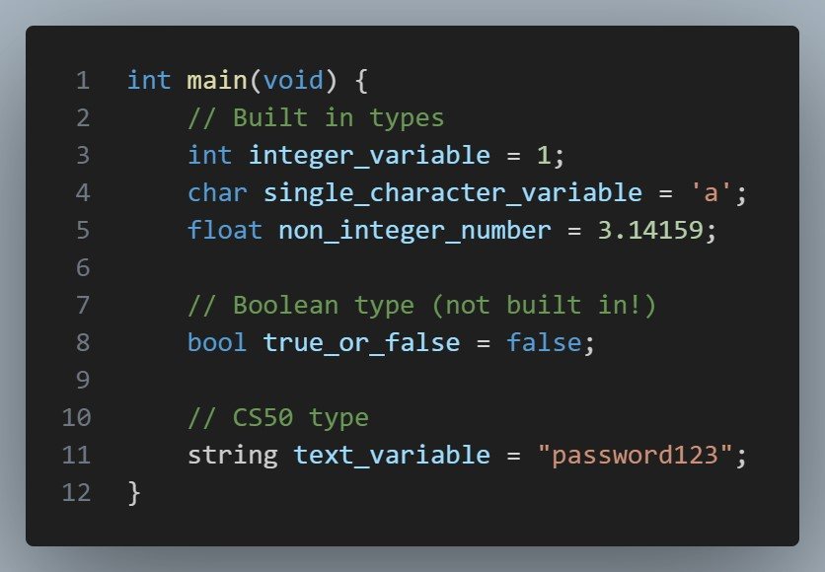
Types in C
Scratch → C

Slide 24
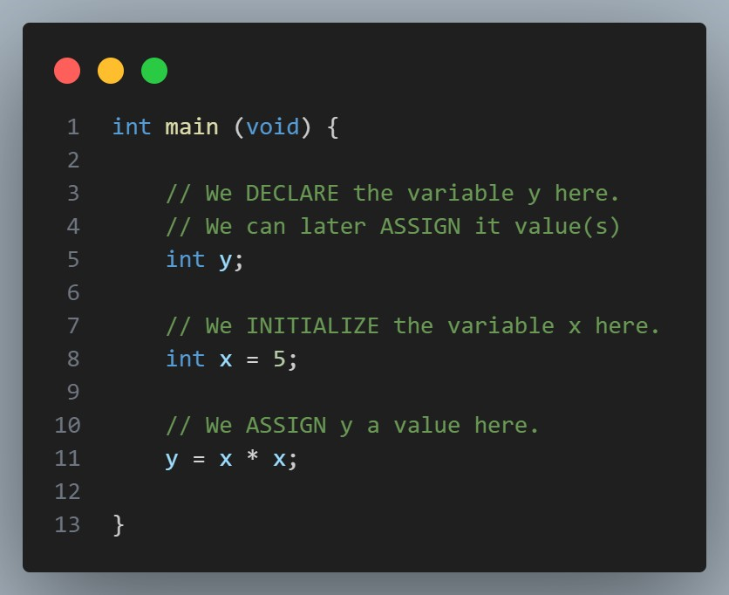
Types in C
Scratch → C

Slide 25
Scratch → C section recap
Scratch → C
We’ve just looked at:
Using printf to print a string or variable.
Using int main (void) to contain code that we want to run!
Using #include to include functions (printf) and even new types (string).
The CS50 manual pages for helpful documentation.
The main C types we will use, declaring, initializing and assigning variables.

Slide 26
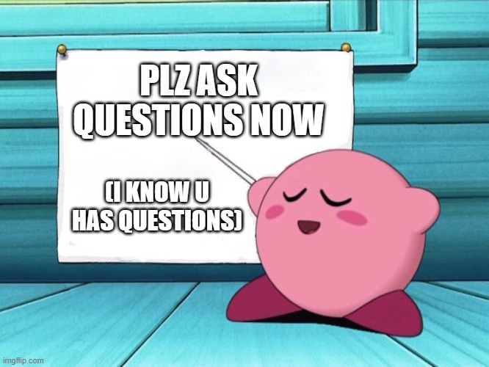

Slide 27
02
Writing code
Getting used to cs50’s tools, mainly cs50.dev.

Slide 28
cs50.dev
cs50.harvard.edu
Gradescope
Ed
Office Hours booking
cs50.ai

Slide 29
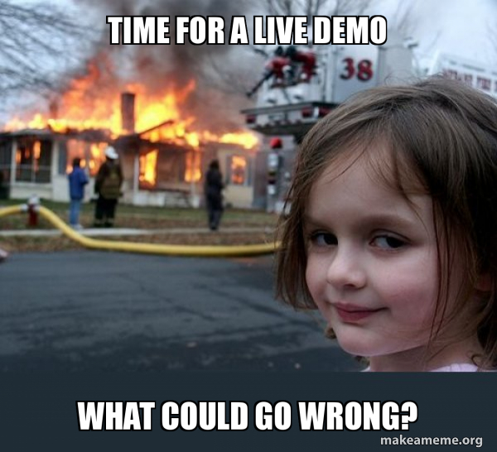
Notes:
Just going to do a quick tour of all of the websites and make sure everyone can get onto cs50.dev to write code before practice exercise on next slide.

Slide 30
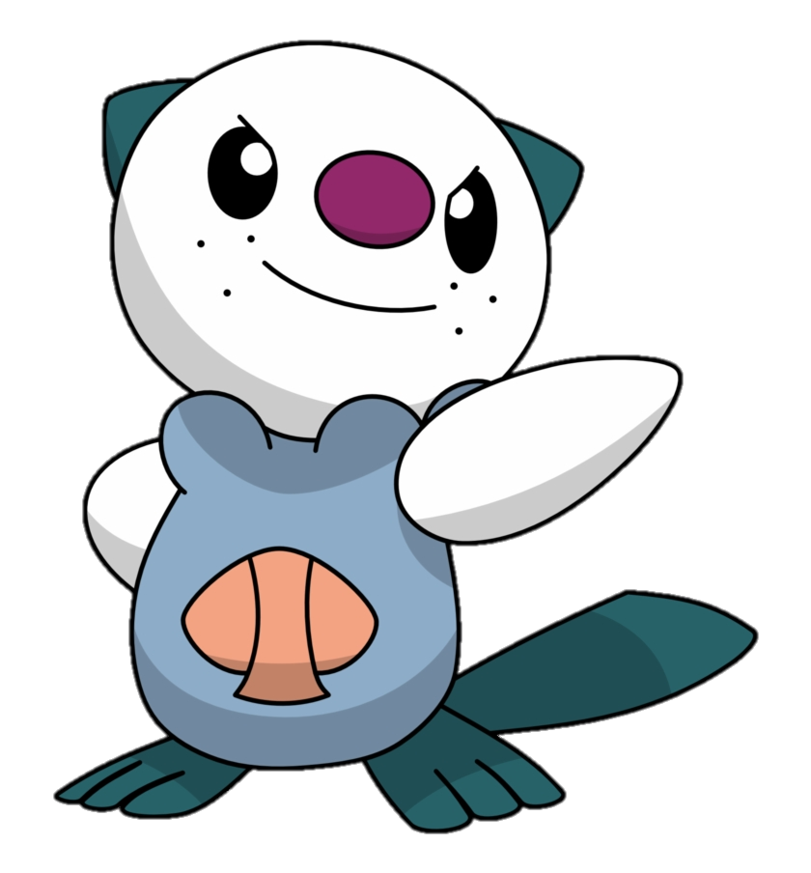
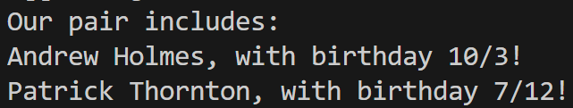
Writing code!
In pairs, write info.c, which should:
Initialize two string variables, with your names.
Initialize four int variables, with your respective birth day and month.
Print to the terminal like so:
Practice!

Slide 31
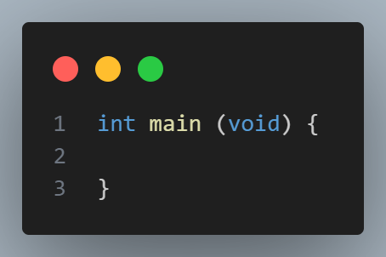
Practice Problem 1 Walkthrough
Writing code!

Slide 32
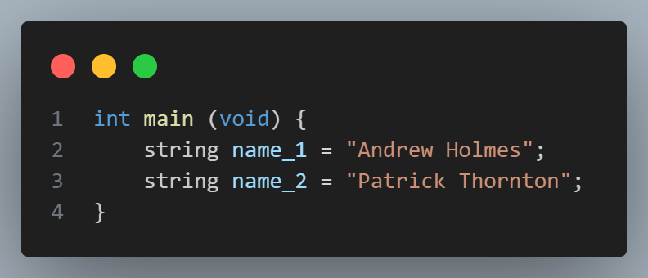
Practice Problem 1 Walkthrough
Writing code!

Slide 33
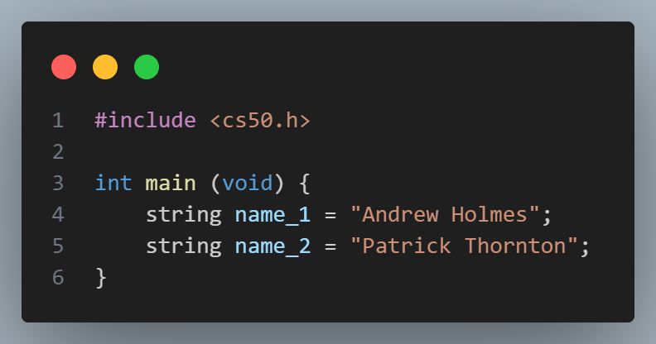
Practice Problem 1 Walkthrough
Writing code!

Slide 34
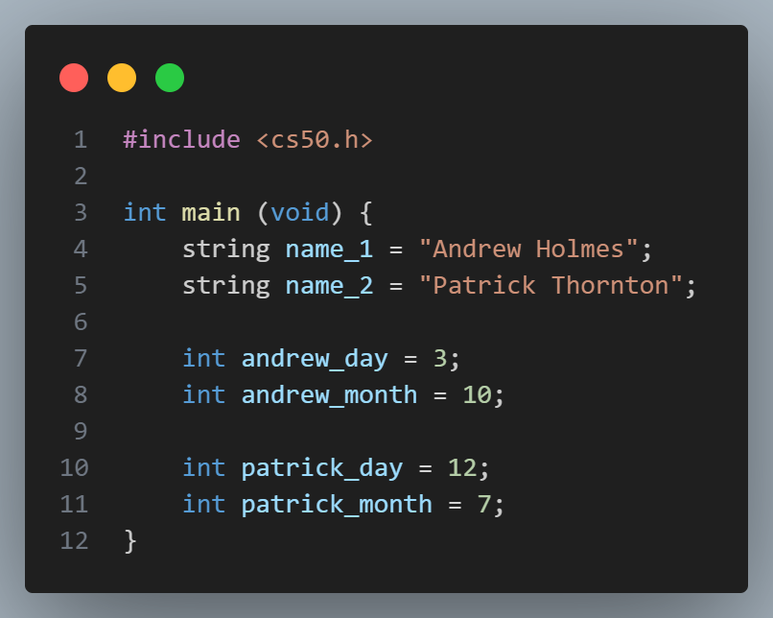
Practice Problem 1 Walkthrough
Writing code!

Slide 35
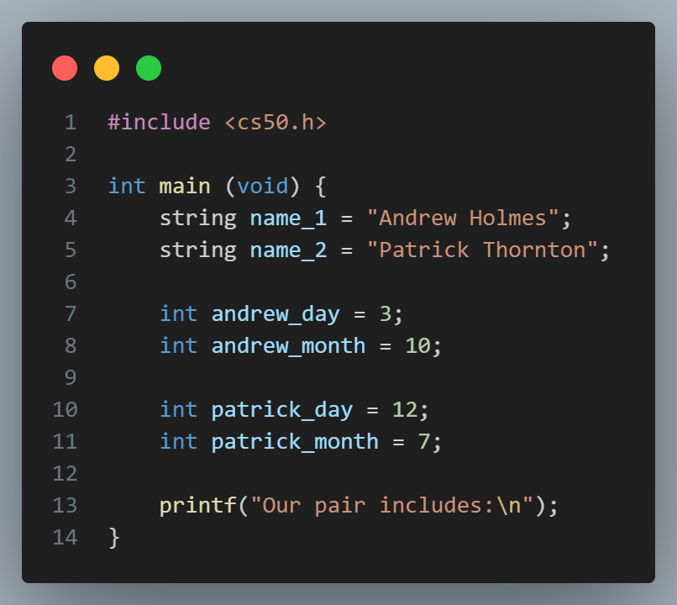
Practice Problem 1 Walkthrough
Writing code!

Slide 36
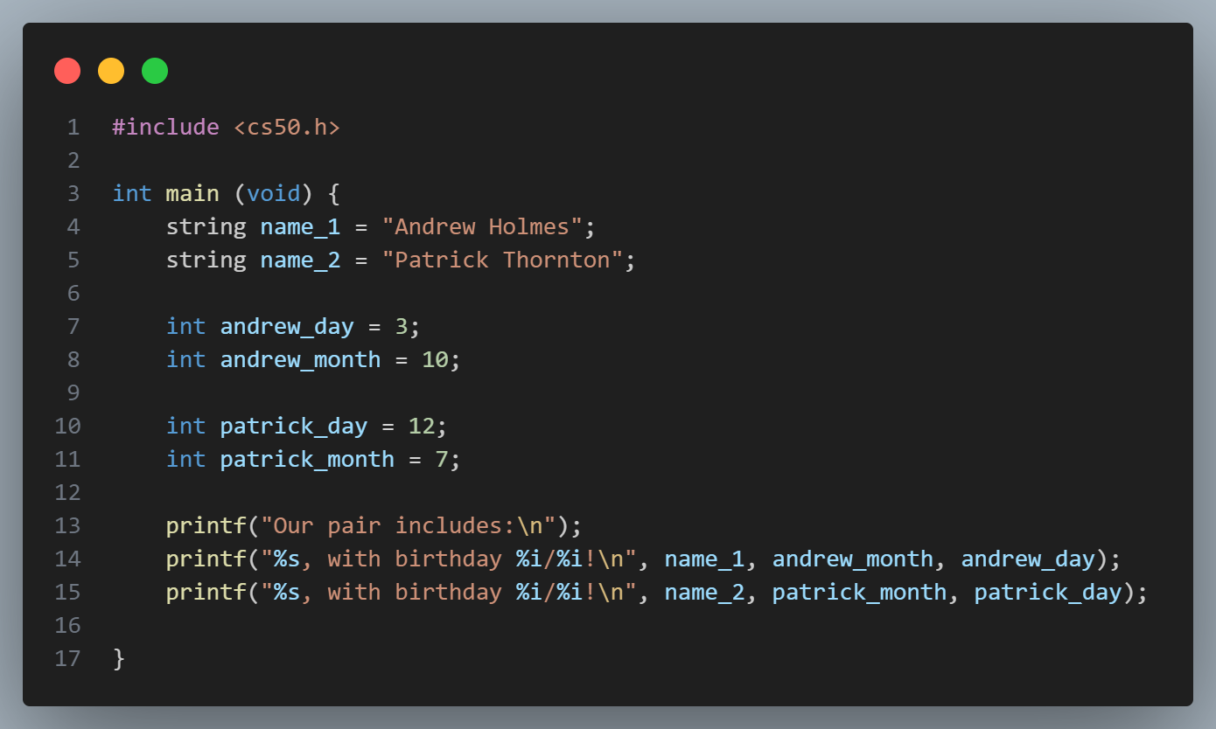
Practice Problem 1 Walkthrough
Writing code!

Slide 37
03
More C!
Understanding C syntax better! It’s time for loops, conditionals and more!

Slide 38
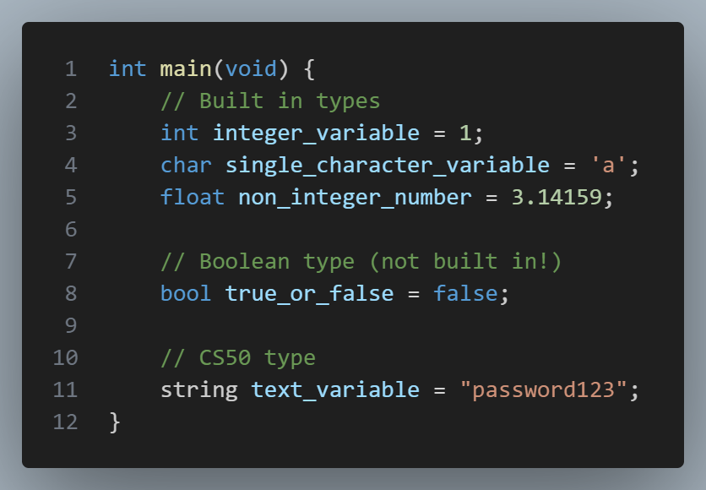
Declaring & Initializing a variable
C syntax

Slide 39
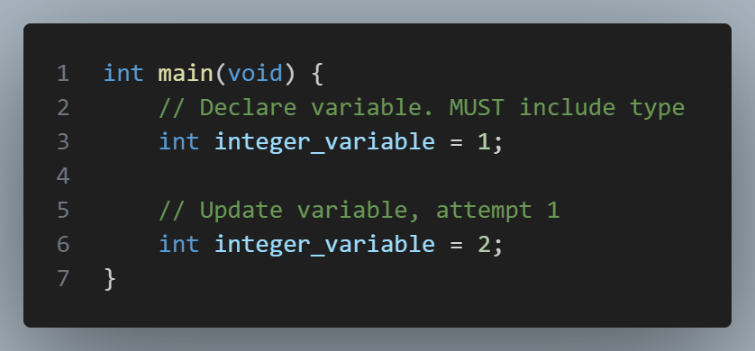
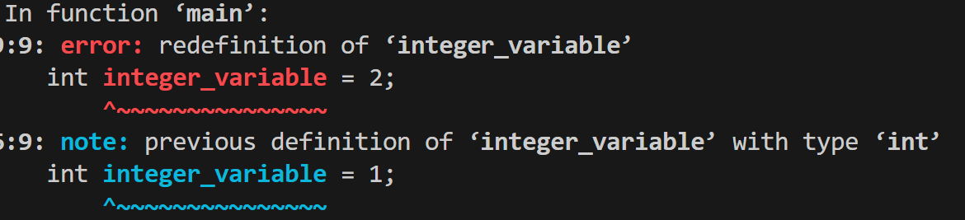
Updating a variable
C syntax

Slide 40
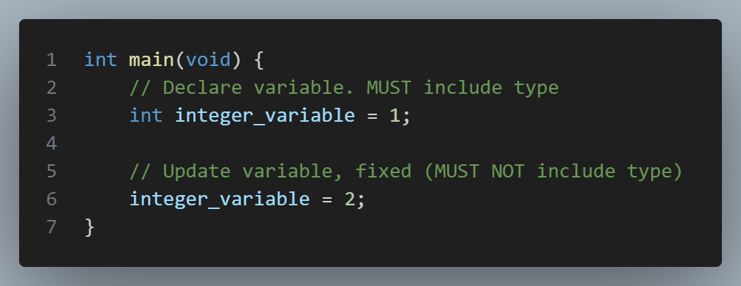
Updating a variable
C syntax

Slide 41
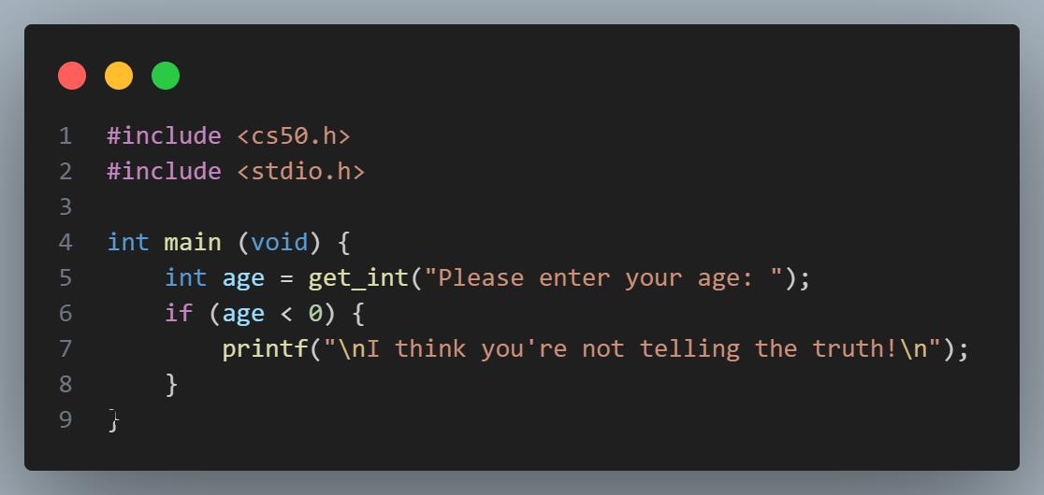
Conditionals
C syntax

Slide 42
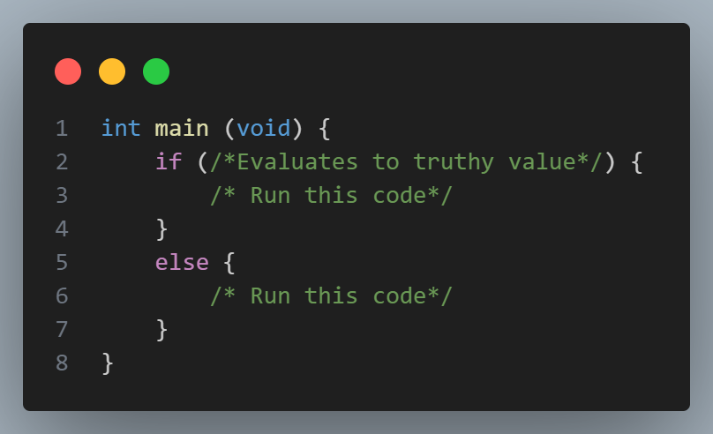
Conditionals
C syntax

Slide 43
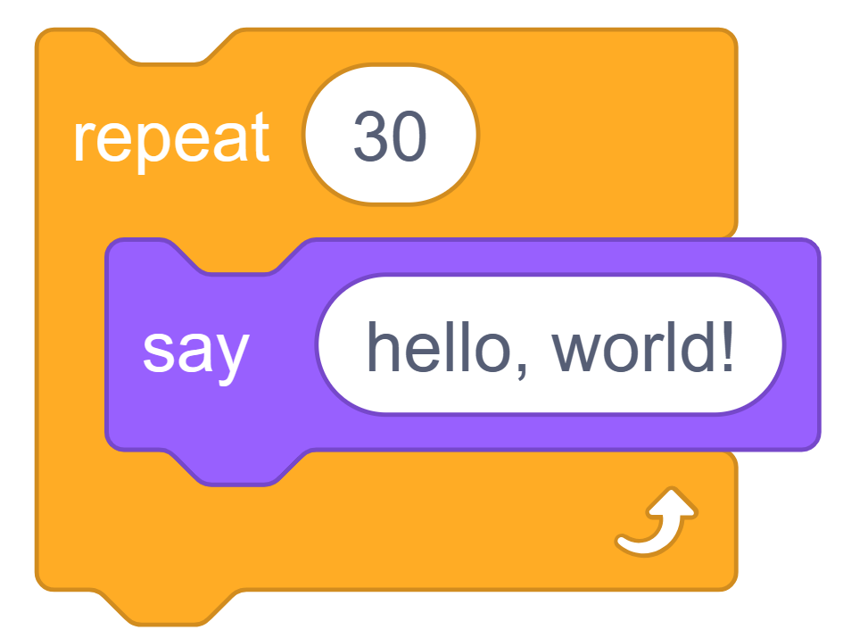
Repetition in Scratch

Slide 44
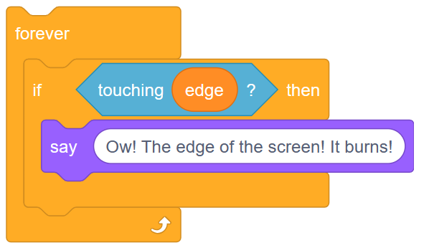
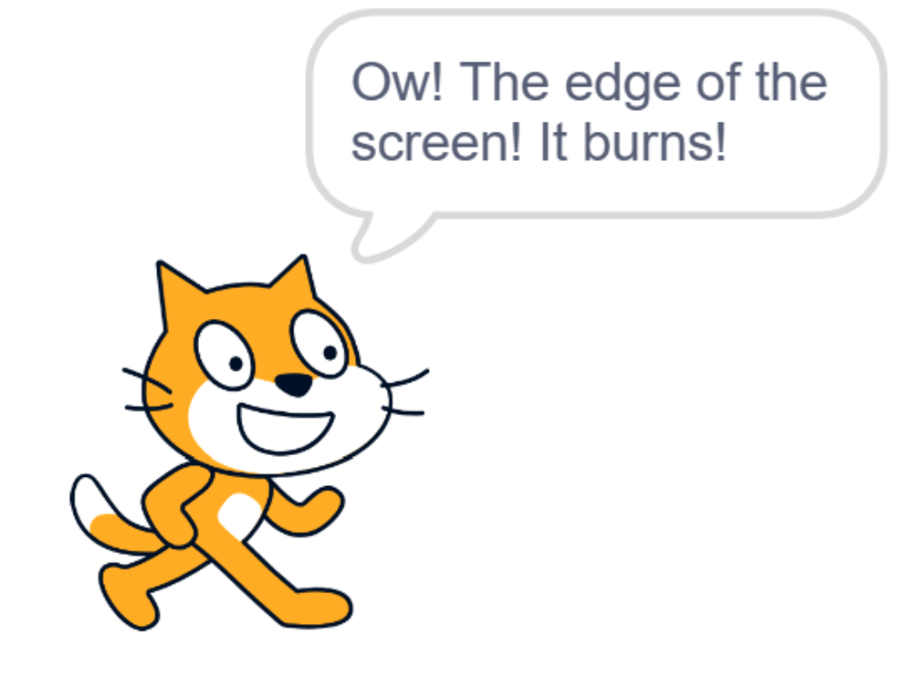
Repetition in Scratch

Slide 45
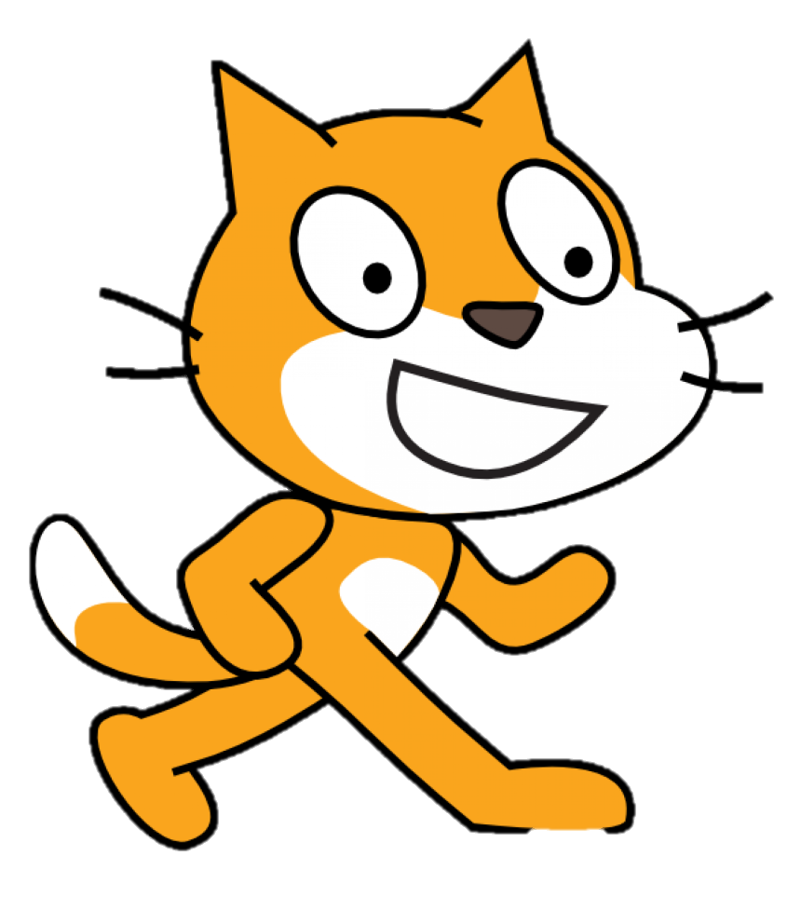
What’s the difference?
A forever loop is better at continuous actions. The cat is in continuous motion, it’s not moving a set number of steps, we want to detect any time in this motion that it hits the edge. This will suit a while loop in C, which will continue looping while something is true (e.g. while the cat is still awake, constantly check if it hit the edge).
A repeat loop is better at discrete repetitions: I want to create 6, or 60 cats, one after another. In C, we would use a for loop. If I wanted to go crazy, I could instead use a while loop such as: while computer hasn’t crashed: add another cat.

Slide 46
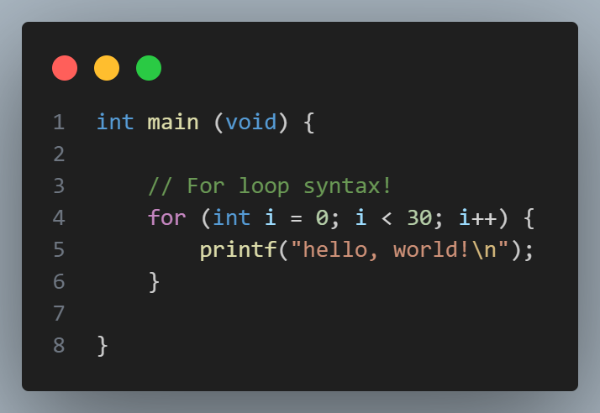
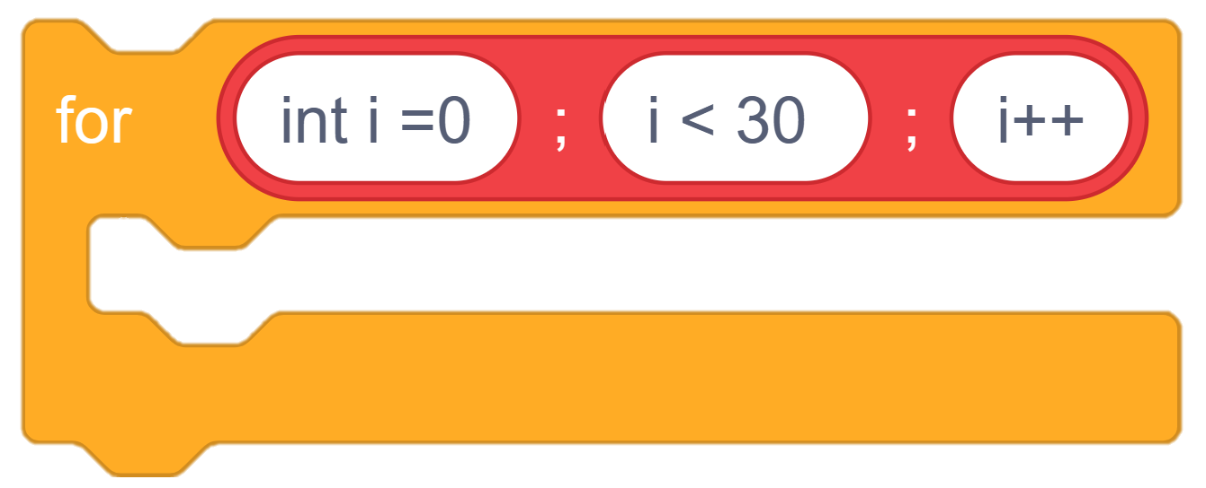
Making the jump to C
C syntax
Notes:
Code to generate scratch C for loop:
for ([int i =0];[ i < 30]; [i++]) {
} ::control stack

Slide 47
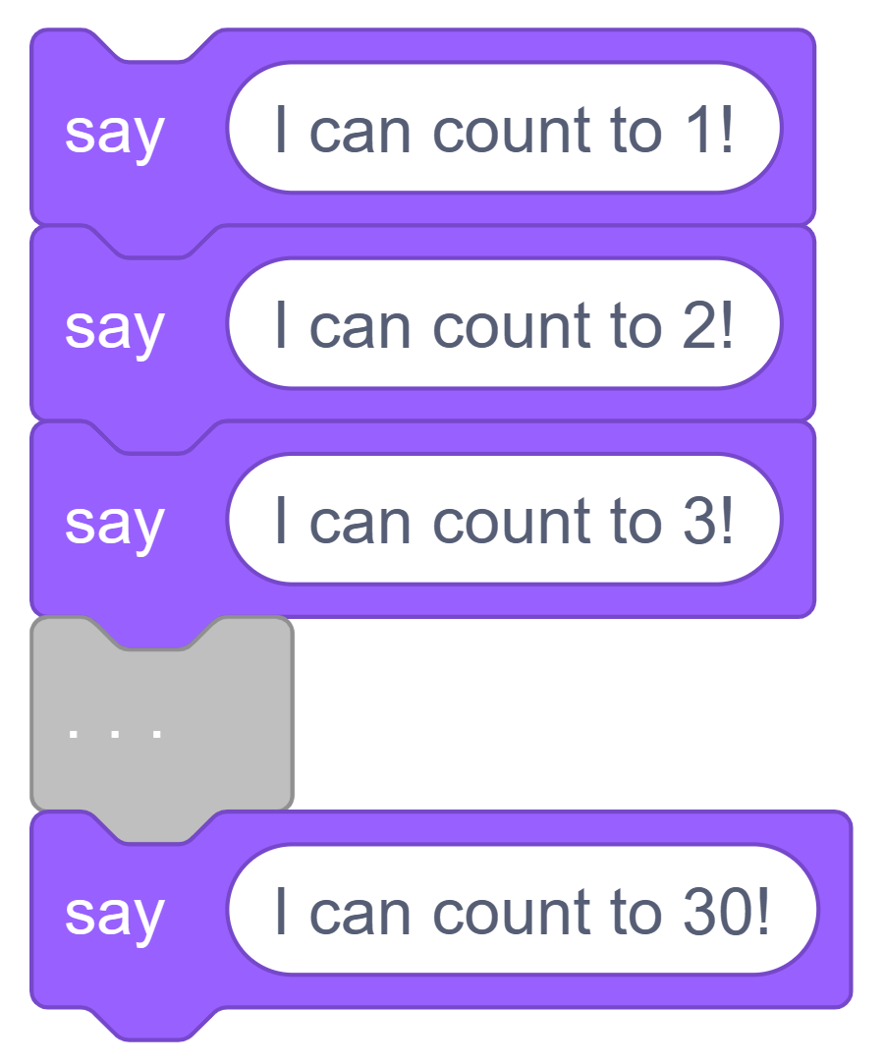
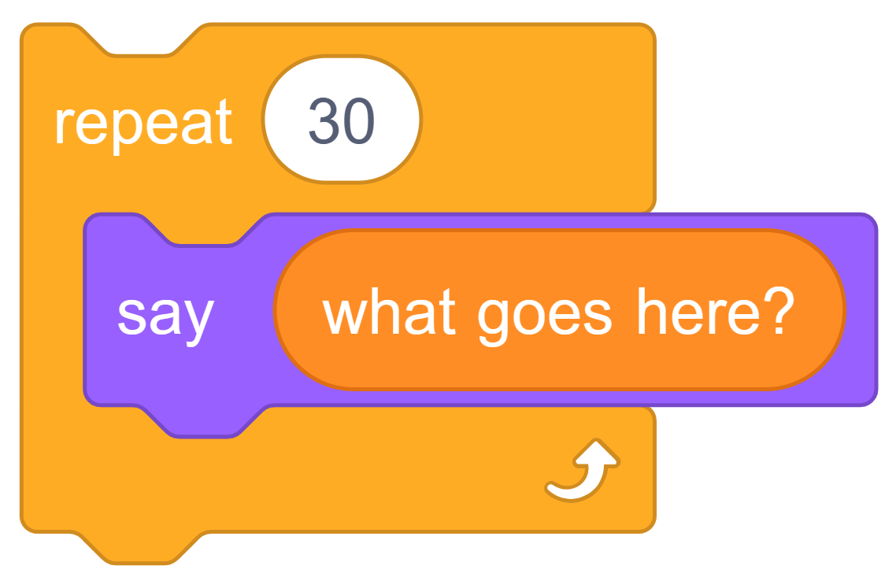
A Scratch problem with ‘repeat’
C syntax

Slide 48
Idea: repetition with storage!
Simply repeating something n times is often useful. However, it’s often useful to know how many times we’ve done something too!

Slide 49
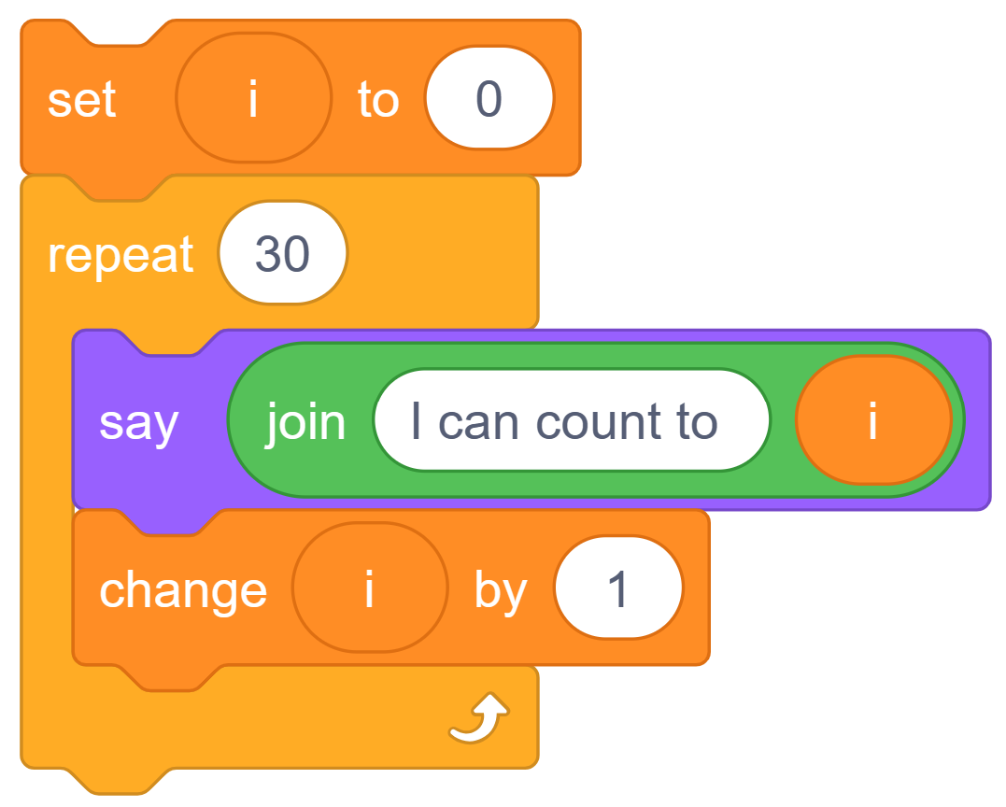
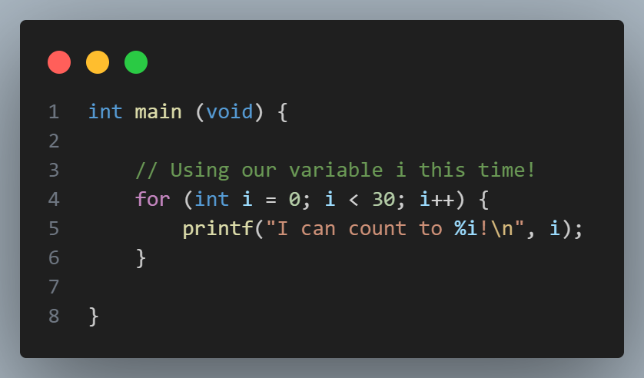
Using a counting variable
C syntax

Slide 50

C syntax

Slide 51
Breaking down the for loop
C syntax
i = 1
Terminal
i = 0
I can count to 0!
I can count to 1!
…
I can count to 29!

Slide 52
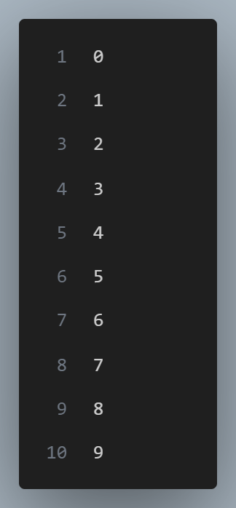

For loop!
C syntax

Slide 53

While loop!
C syntax

Slide 54

Do-while loop!
C syntax

Slide 55

C syntax
Attribution: C Programming Course Notes - Looping Constructs (uic.edu)

Slide 56
For vs While vs Do-while
C syntax
For: generally for fixed/known number of iterations.
Example: for every user, do…
While: generally for continuous operations.
Example: while server online…
Do-while: generally for continuous operations which need to be run at least once.
Example: checking user input

Slide 57

C syntax
In new pairs, write mario_right.c:
Get an integer variable height from the user. (you should check > 0)
Print the right side of the mario pyramid:
Practice!

Slide 58
Operators
C syntax
Arithmetic operators:
+ - / * %

Slide 59
Operators
C syntax
/ is a floor division (ROUNDS DOWN) when used on integers in C
Be wary of this! Although it might help you somewhere in this week’s PSETs…

Slide 60
Operators
C syntax
% gives the remainder (modulo)
5 / 3 = 1
5 % 3 = 2
5.0 / 3 = 1.66667
This might also be useful elsewhere in this week’s PSETs…

Slide 61
Operators
C syntax
Relational operators:
< <= == != >= >

Slide 62
Operators
C syntax
Logical operators:
&& || !

Slide 63

Operators
C syntax

Slide 64

C syntax
Challenge
What do you think this code does? Discuss in pairs.

Slide 65

Strings
C syntax

Slide 66
Section Summary
C syntax
We’ve just looked at:
Conditionals (if-else)
Loops (for, while, do-while)
Common operators (Arithmetic, relational and logical)
Brief info on strings (strlen, accessing individual chars)

Slide 67
3.5
Extension
Time dependent, a little push further :P

Slide 68

Extension
Quiz! (1)
Do you think this is valid C code?

Slide 69

Whitespace
Extension
Whitespace is not totally ignored (e.g. you need a space between int and x to distinguish), but the quantity of whitespace doesn’t matter.

Slide 70

Pure programming
C syntax

Slide 71

Side effects
C syntax
printf returns an int. As a side effect, it puts something in your console.

Slide 72

Variable scope
C syntax
J is re-initialized every time through the for loop.
After the for loop, j goes out of scope.
So we can redeclare/ initialize j again

Slide 73


The whole process, in Scratch terms

Slide 74
04
PSET thoughts!
A quick think about the week ahead!

Slide 75


PSET overview for the week
Hints
What did we say was a good tool for getting user input (possibly repeatedly)?
Number the lines. How many hashes and spaces on each line? What loops could be helpful?
Where should you print a new line?
PSETs
Mario

Slide 76

PSET overview for the week
PSETs
Cash
Hints
Which coins should you check for first?
How could you tell 50 requires two coins quickly?
Is there any operator that could be of particular use here?

Slide 77

PSET overview for the week
Hints
Two ways of thinking, card number as a string or as an int.
If int, how can you get each digit (consider some of the operators). E.g. end digit you can get with % 10.
If string, consider atoi function, or use ASCII to convert string <-> int.
PSETs
Credit
NOTE: This is significantly more work than cash. This is one of the largest differences between the less/more PSET versions, beware.

Slide 78

Thanks for coming!
Don’t forget attendance code →

Slide 79
05
Bonus quizzes
Left over stuff that might still be interesting if you’re here browsing my slides ☺

Slide 80

Valid C? (1)
Write your answer here. Is this valid C code? Why or why not? If not, explain how to fix it. What do you think it does?

Slide 81

Valid C? (2)
Write your answer here. Is this valid C code? Why or why not? If not, explain how to fix it. What do you think it does?

Slide 82

Valid C? (4)
Write your answer here. Is this valid C code? Why or why not? If not, explain how to fix it. If it is valid, what do you think it does?

Slide 83

test
Valid C? (5)
Write your answer here. Is this valid C code? Why or why not? If not, explain how to fix it. If it is valid, what do you think it does?

Slide 84

test
Valid C? (6)
Write your answer here. Is this valid C code? Why or why not? If not, explain how to fix it. If it is valid, what do you think it does?

Slide 85

test
Valid C? (7)
Write your answer here. Is this valid C code? Why or why not? If not, explain how to fix it. If it is valid, what do you think it does?

